Slide 1
Design Patterns: Fluent Builder & Decorator
Micro Learning
André Guedes
October 2018

Slide 2
Agenda
Fluent Builder
Pros & Cons
Decorator
Pros & Cons
Demo

Slide 3
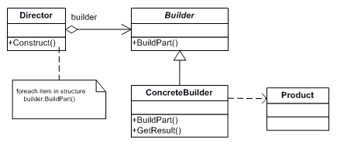
Fluent Builder
Separate the construction of a complex object from its representation;
Same construction process = different representations;
Fluent construction gives an API like interface to object creation.

Slide 4
Fluent Builder
Pros
Readability to both software developers and business stakeholders;
Constructors and methods with less parameters;
Easy creation of test objects;
Cons:
Method chaining;
Methods don’t make sense on their own.

Slide 5
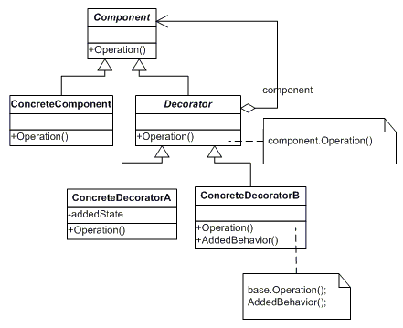
Decorator
Attach functionality to an object dynamically;
Alternative to sub classing.

Slide 6
Decorator
Pros
Avoid huge classes;
Open/Close principle;
Can be stacked on top of each other;
Cons:
Lots of small classes;
Creating objects with many responsibilities can become messy.

Slide 7

Follow me
https://github.com/afmguedes/DesignPatterns

Slide 8
Design Patterns: Fluent Builder & Decorator
Micro Learning
André Guedes
October 2018

